Slide 1
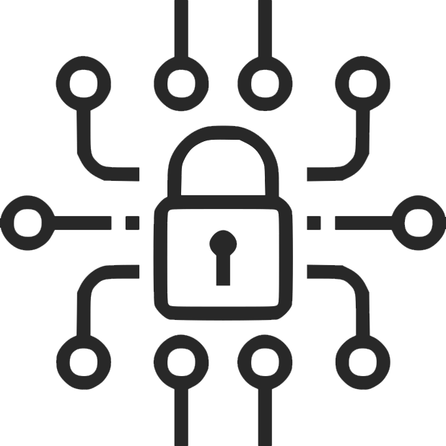
Digital
Lineup
By Olav Sharma – Tier 4

Slide 2
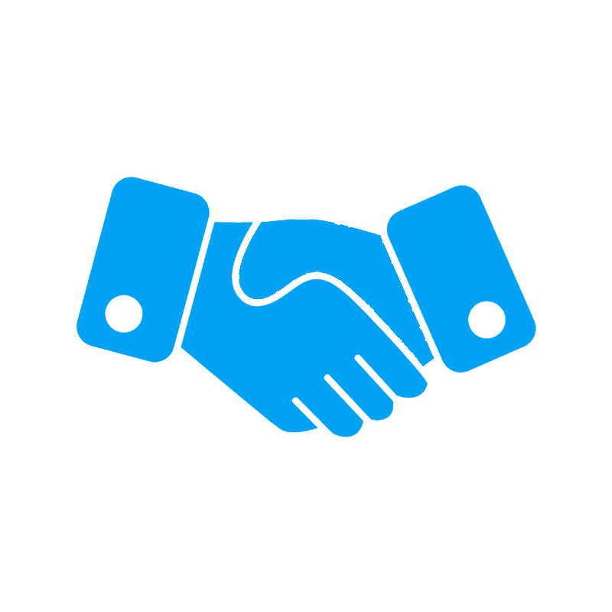



Intro
This Presentation covers the four parts of Digital Lineup,
These four parts of the Digital Lineup are key in keeping you safe, private, secure, and responsible. The next two slides cover security, the two after cover footprint, and so on.
Security,
Footprint,
Citizenship,
and Safety.
Notes:
This presentation covers the four following parts of digitallineup. Security. Digital Footprint. Digital Citizenship. And Safety.

Slide 3
Ch. 1
Security is really important online. Keeping your online accounts secure is extremely important now-a-days with hacked accounts databases, or really most other things being really common nowadays. Two things that are really important for staying secure when online are keeping accounts secure with 2FA, stronger passwords, etc. And understanding how these breaches work and how to protect yourself from them.
Security
The following slides cover securing your accounts, and the importance of security online.
Notes:
Security. Security is really important when online. Keeping your account secure is only gonna get harder. The following slides talk about securing your accounts and why securing them is important.

Slide 4
Why is Security important?
Security is really important for a number of reason. Three really important reasons are below.
Secure accounts keep your personal info private. Lots of companies store your full name, date of birth, phone number, and sometimes more information. When people log into your accounts, they can usually see some of this information.
Having secure accounts is also important for bank accounts or similar. Nowadays, lots of services such as Google, Samsung, or similar keep your payment methods saved on your account. This makes it really easy for people to use your own money. Lots of these services save virtual cards used for real-life payments using NFC. This means people can use your money in real life too!
Access to a Google, Microsoft, Samsung account or similar grants other account passwords. Many services such as Google, Microsoft, and Samsung. Store passwords for other services in the cloud. Some examples are Google’s password manager, Samsung Wallet Pay, and Microsoft’s password service. This is usually only vulnerable if they use these services though.

Slide 5
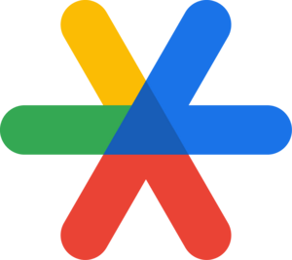

Secure your accounts
Securing your accounts is really important, due to how common and easy it is to hack accounts nowadays. To secure your accounts, some general steps are to make a strong password, numbers, letters, symbols, anything! Just make sure you remember it. Next, if the service offers 2FA, enable it. Use your phone for authenticator codes, or use an email code for 2FA. Some great authenticator apps include Microsoft’s authenticator and Google’s authenticator. These are really helpful because they back up your codes between devices through the cloud, just be sure that you’ve enabled it if you were using the app before they started backing them up.

Slide 6
Ch. 2
Digital Footprint

Slide 7

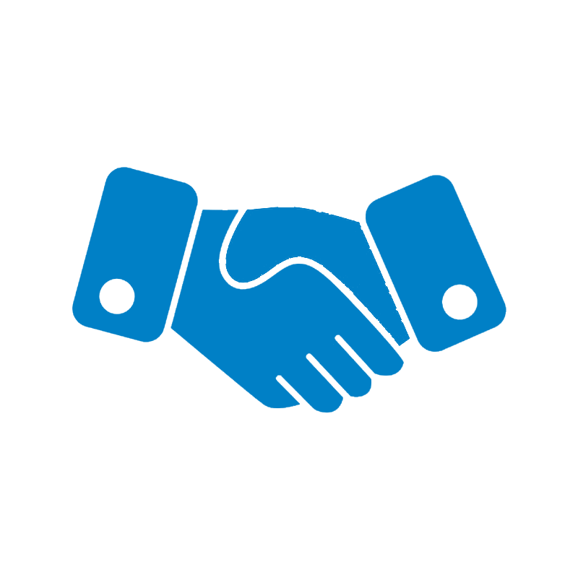

How is your data stored?
balbasdiJASioufjsedifu ahsdiofay uhgsdfiuayshjdfiaysed
Notes:
How data is stored
For all you visual learners, I’ve created a diagram. Here’s a lock from the second slide. Here’s the hand. We put the key in the hand. The hand and the key work together to open the lock. And under those things is the database.

Slide 8
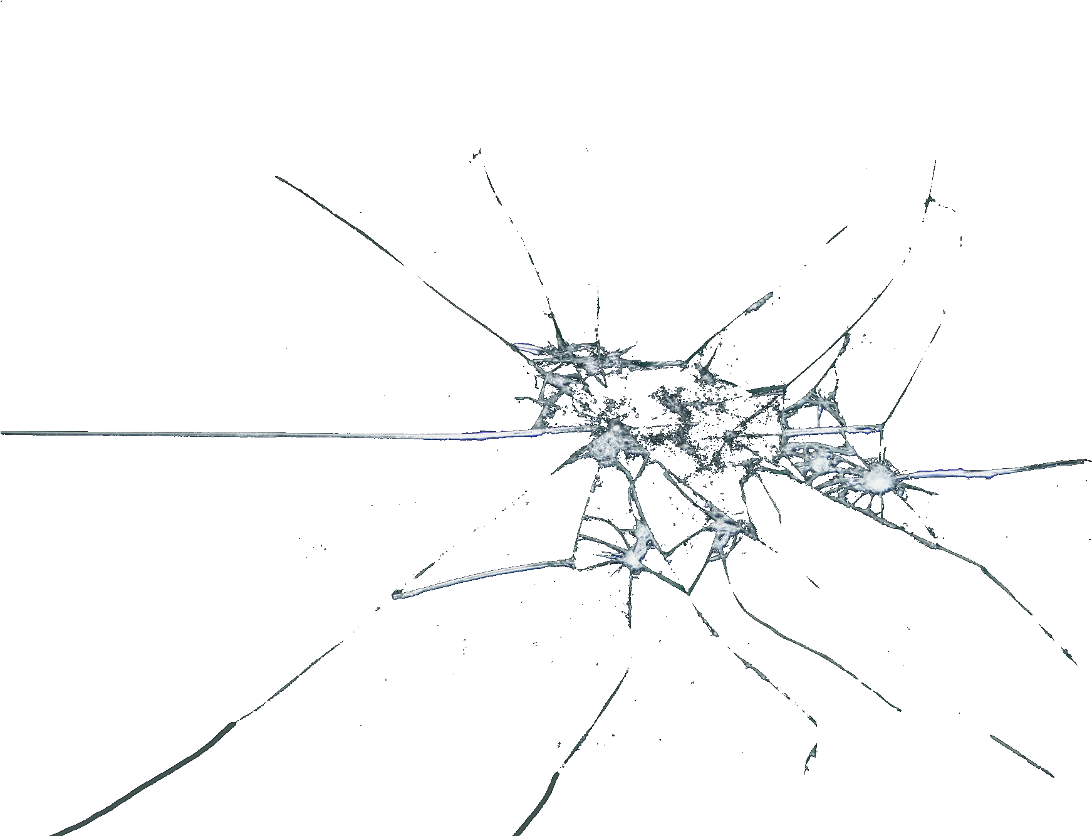
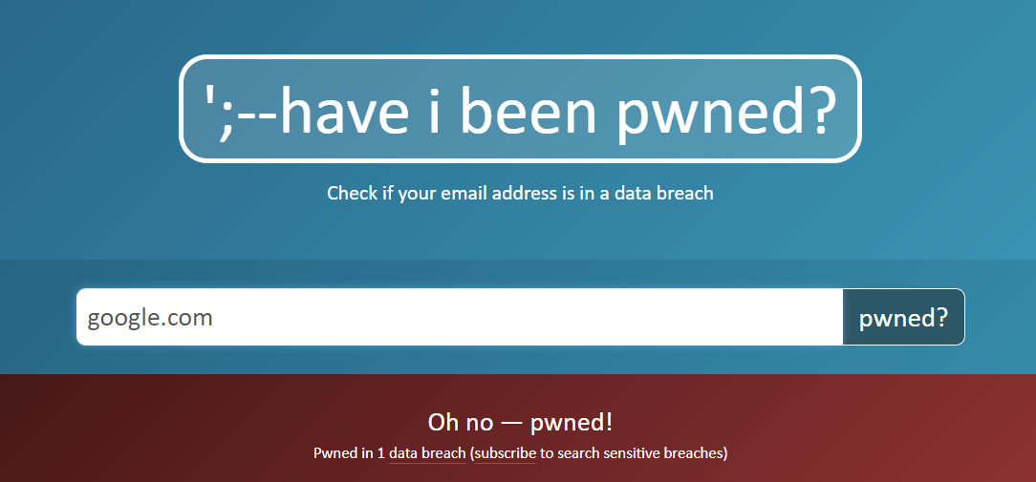

Data Breaches
These breaches are starting to become really common, represented by this graph.
2019: Breaches on the rise
2020: With the pandemic, people use computers more and more often. More information to steal.
2021 Even more people use computers on a daily basis, lots of information to steal.
2022 Even more info to steal. These are only going to rise.
Data breaches are when companies’ databases get breached and leaked to the hacker.
These are dangerous because databases hold everything that these companies know about you, including information you’ve given them.
Some companies choose to store different information in different databases and is becoming more common for them to have different encryptions. This is a step in the right direction to cut these breaches out.
Most of the time, the most vulnerable information other than personal information, your account password.
Hackers can use the passwords they find in data breaches, match them to the username, and use them to decode passwords to other site logins. A way to counter this is to use different passwords for different sites.
If you would like to find out if you’ve been in a breach, you can go to haveibeenpwned.com.
Notes:
1.
2. This graph represents the rise in data breaches from 2019 to 2022. You can see how it goes up during the pandemic, and keeps rising and oh, shoot. I broke the ceiling. Oh… There it goes

Slide 9

Ch. 3
The most important thing to know when online is how to stay safe. Safety is really important nowadays because of the increase of crime online.
Key parts these slides cover include
Being anonymous
Avoiding strangers
Don’t share private things
Why this is important
Safety
The following slides cover how to stay private, how to stay safe, and why safety is so important.

Slide 10
Ch. 4
Citizenship, citizenship online can also be thought of as responsibility.
Some key parts of responsibility or citizenship include
Following a set of general ground rules
Following laws
Following the ToS and agreements for platforms you use
To know why this is important
Citizenship
The following slides cover how to be responsible online, and why it’s so important.

Slide 11
The Importance of Responsibility Online

Slide 12
Rules
☹

Slide 13
Ch. 5
The following slides are an overall conclusion to the presentation. The conclusion covers the most important takeaways from subjects from this presentation: security, digital footprint, safety, & responsibility.
Conclusion
The “Conclusion” section covers similarities & differences and works cited.

Slide 14
Similarities & Differences
Security
Footprint
Safety
Citizenship

Slide 15
Works Cited
“Olanorw Website.” Olanorw, olanorw.com. Accessed 24 Apr. 2024.
“Olav’s Portfolio.” Olav Sharma, osvar.org. Accessed 24 Apr. 2024.

